Slide 1
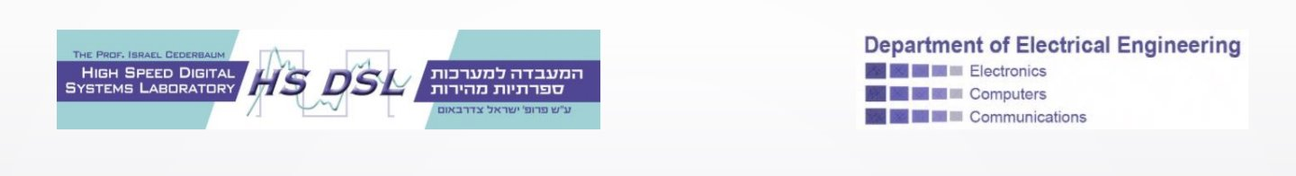

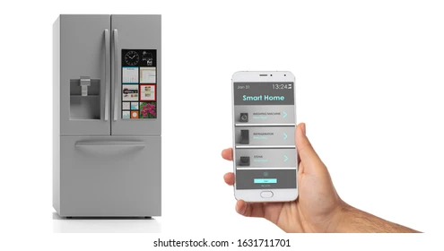
Smart refrigerator using ai - Part B
Supervisor: Mony Orbach
Students: Raghad Badarny, Mohammed Ghanaiem
Final Presentation
Spring 2025

Slide 2
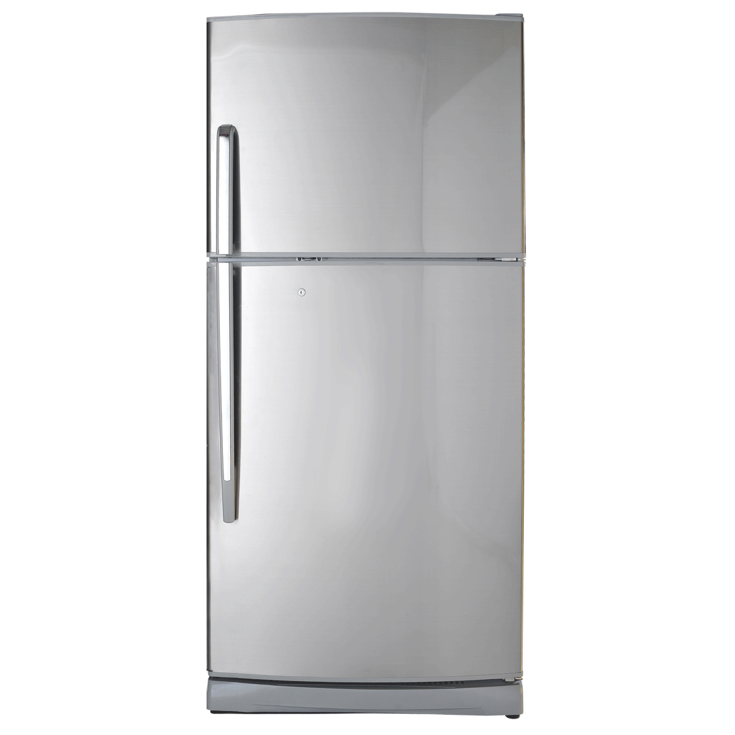
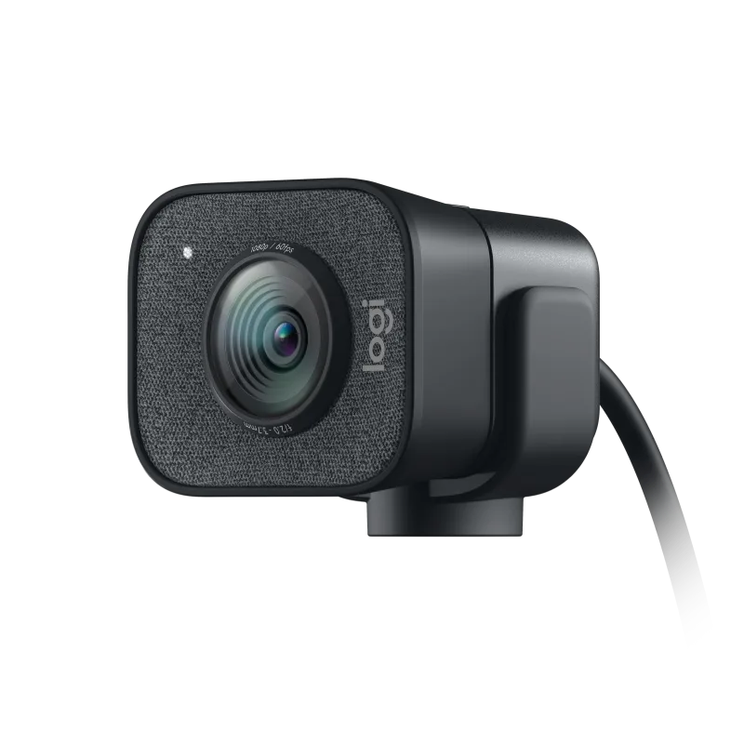



Background
Part A: Local system
Part B: Connect to cloud and server, then add an application.
Notes:
Mohammed

Slide 3
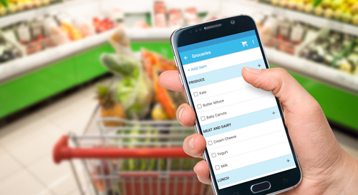
Motivation
To enhance the practicality of the refrigerator, it was expanded beyond a local-only system and connected to the cloud.
The addition of a mobile application and AWS services, the smart refrigerator becomes:
More useful in daily life
Offering live updates
Remote access anytime, anywhere
Notes:
Mohammed

Slide 4
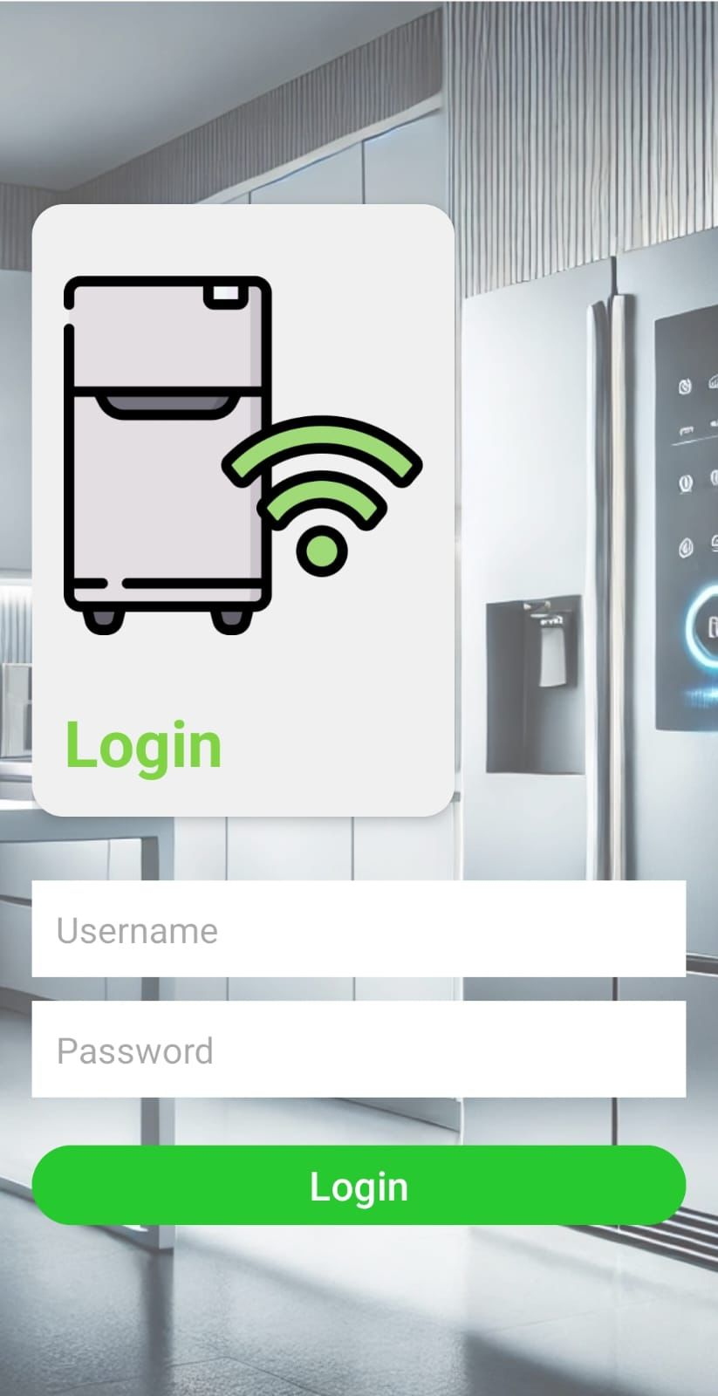

Final Product
We developed an app to manage a Smart Refrigerator shopping list.
The app allows:
User login with username and password.
Viewing the shopping list items.
Refreshing the list.
Deleting items both from the app and from the AWS database.
Logging out securely.
The app layout is adjusted for both English and Right-to-Left (e.g., Arabic/Hebrew) devices.
Notes:
Mohammed

Slide 5
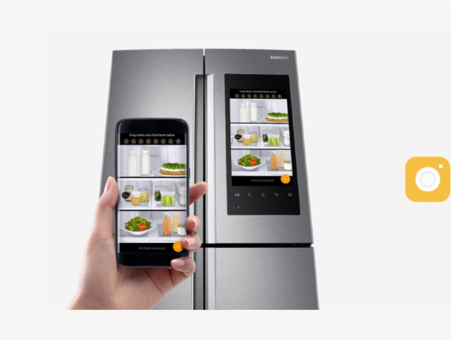
How it works
Reminder Part A
System automatically identifies objects.
Result will be shown on the touch screen.
User’s confirmation & inserting expiration date manually.
Added to appropriate list.
Notes:
Mohammed

Slide 6
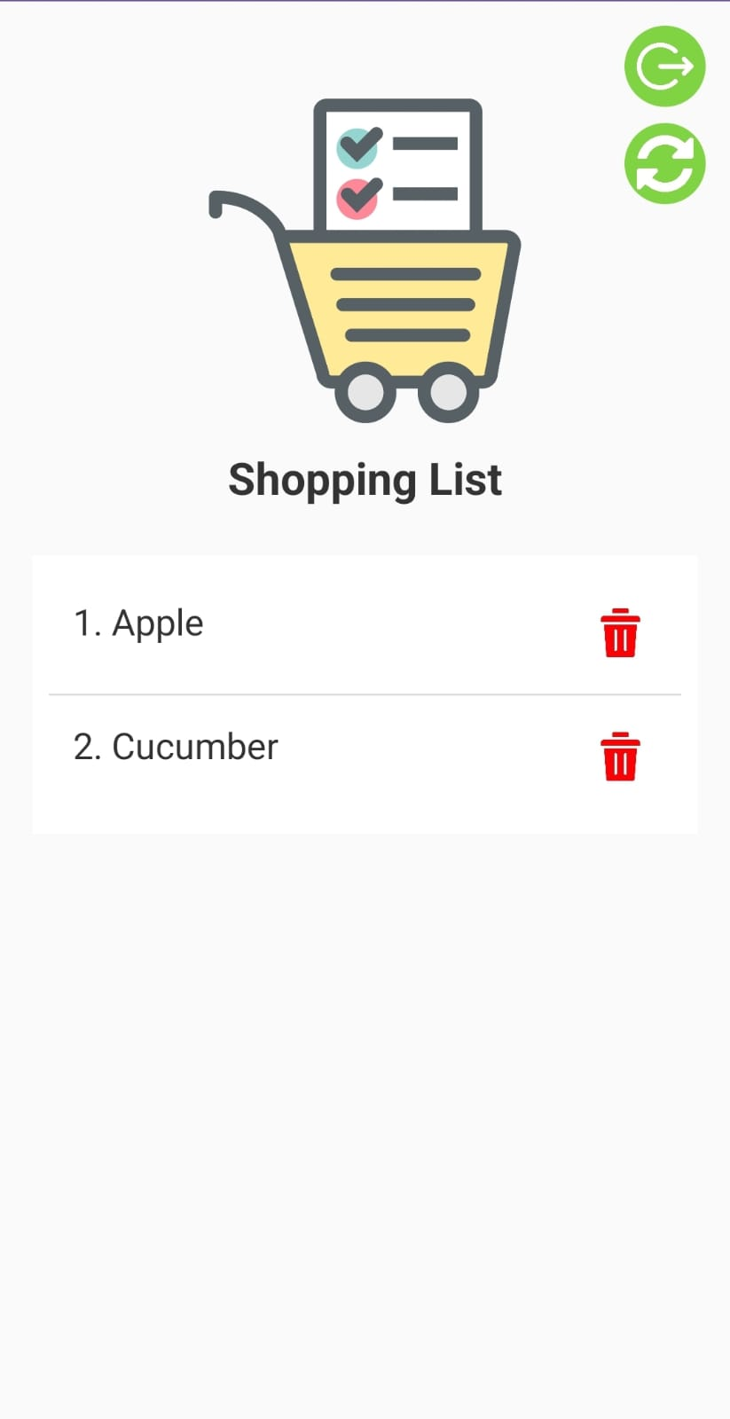
How it works – Part B
Create an account
Install the App
Log In
View & Update Shopping List
Notes:
Raghad

Slide 7





Software Block Diagram
Part B
Cloud
Application
Data Base
AI
Management
GUI

Slide 8
Tools and Technology
Android Studio | App Development
Python (Aws) , Java (App) | Programming Language
AWS DynamoDB (NoSQL Cloud Database) | Database
AWS Cognito | User Authentication
AWS Lambda Functions | Server Logic
Created a signed APK file for installation | App Packaging
Custom icons and background images | Design and Graphics

Slide 9



AWS (Amazon Web Services)
In this project, AWS is used to connect the fridge to the cloud, allowing data like the shopping list to be updated and synced instantly between the fridge and the mobile application.
Notes:
Raghad

Slide 10

AWS Lambda
Runs small pieces of code without creating or managing servers.
No need to set up a full backend server
Only runs when needed → saves cost and resources
Scales automatically with your user base

Slide 11
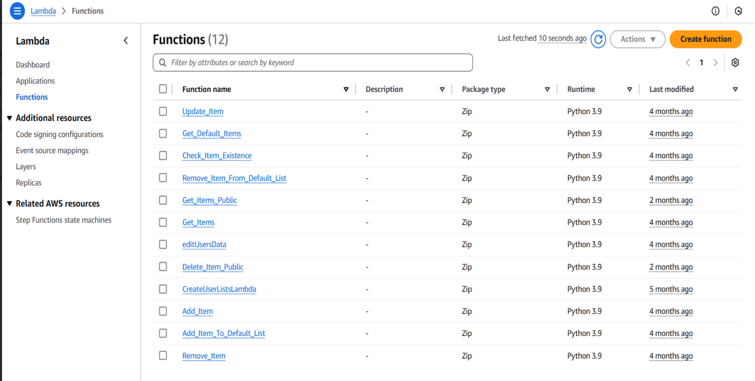
AWS Lambda

Slide 12
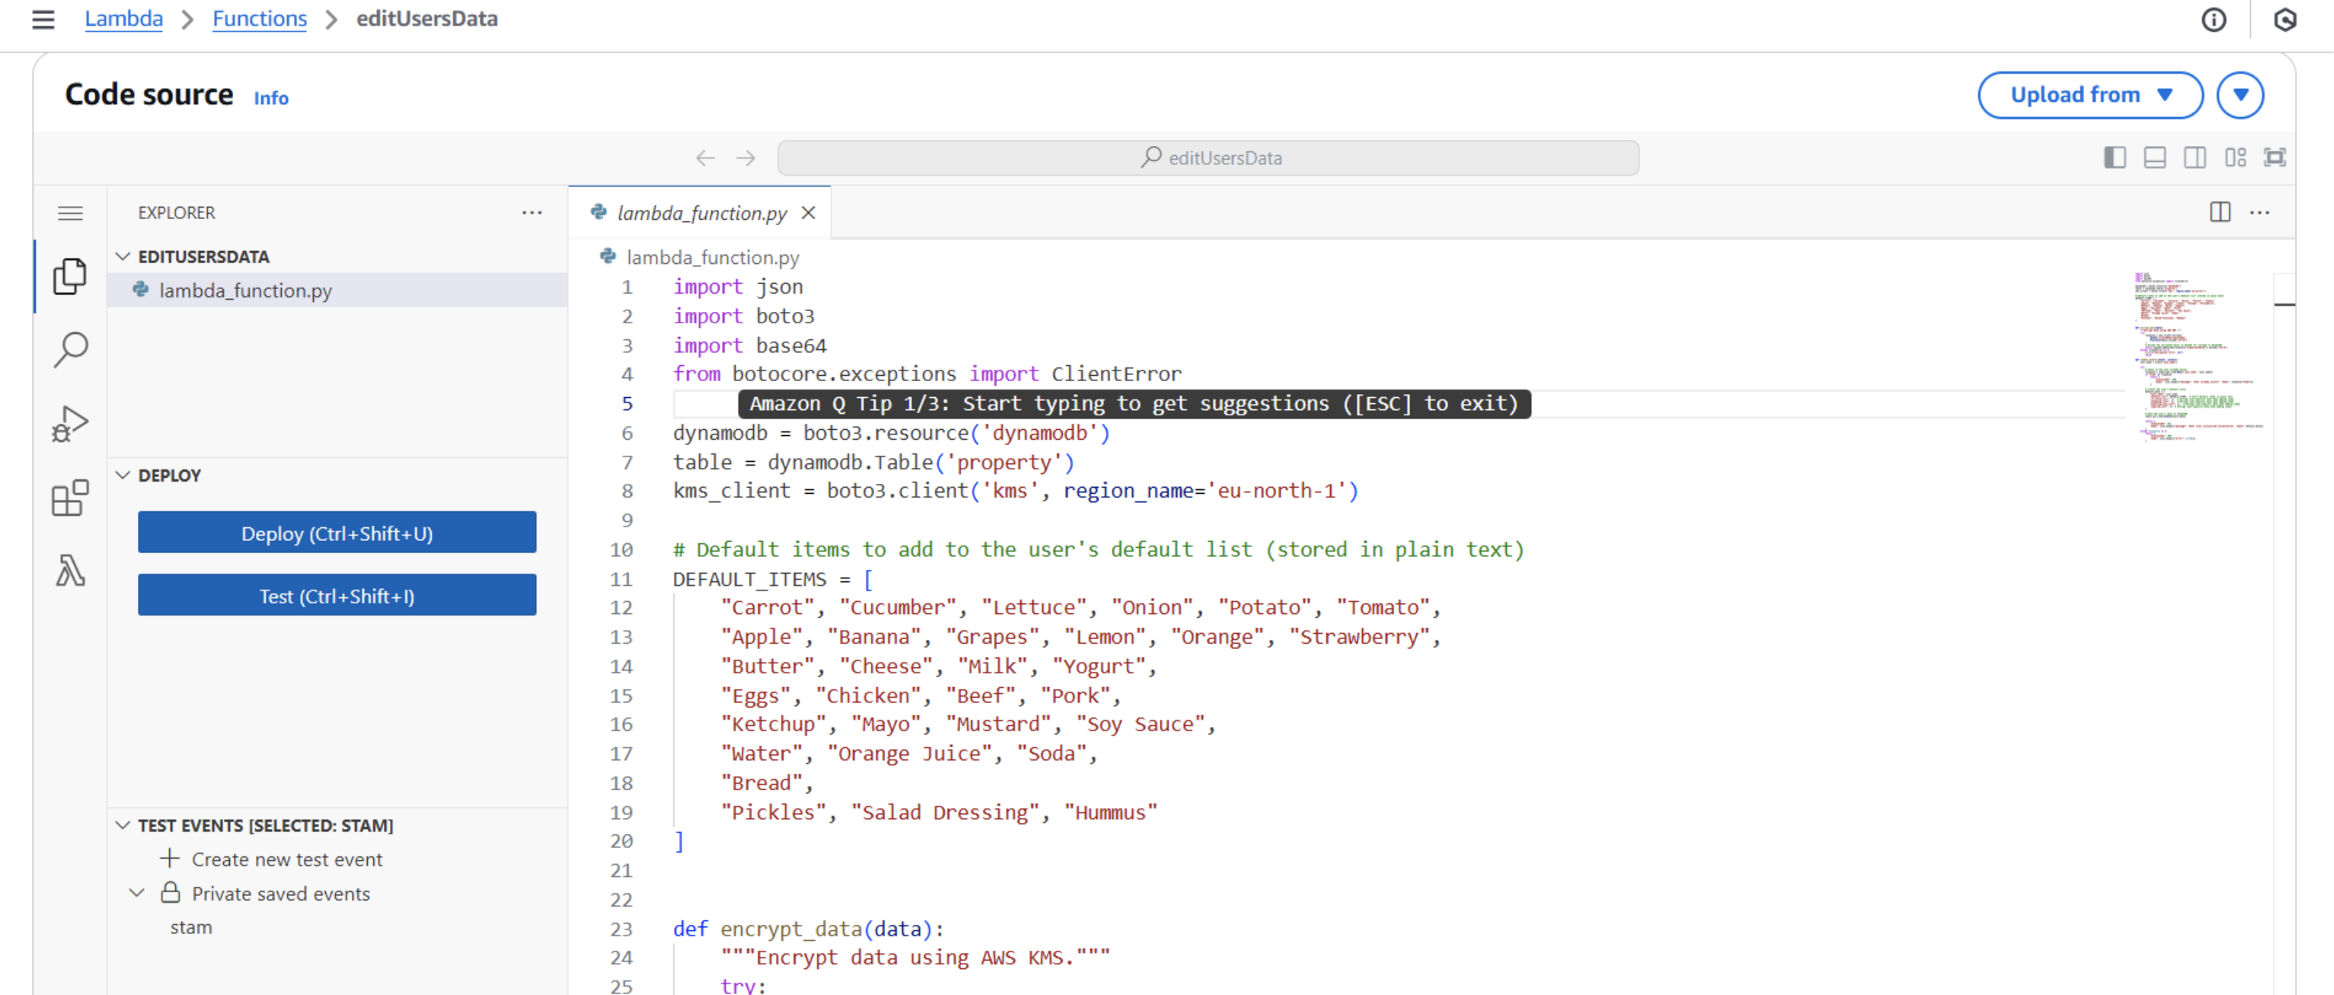
AWS Lambda

Slide 13
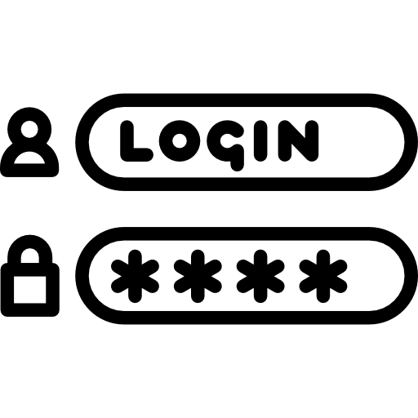

AWS Cognito
Handles passwords and security properly.
Supports multi-device login.
Works well with other AWS services.

Slide 14
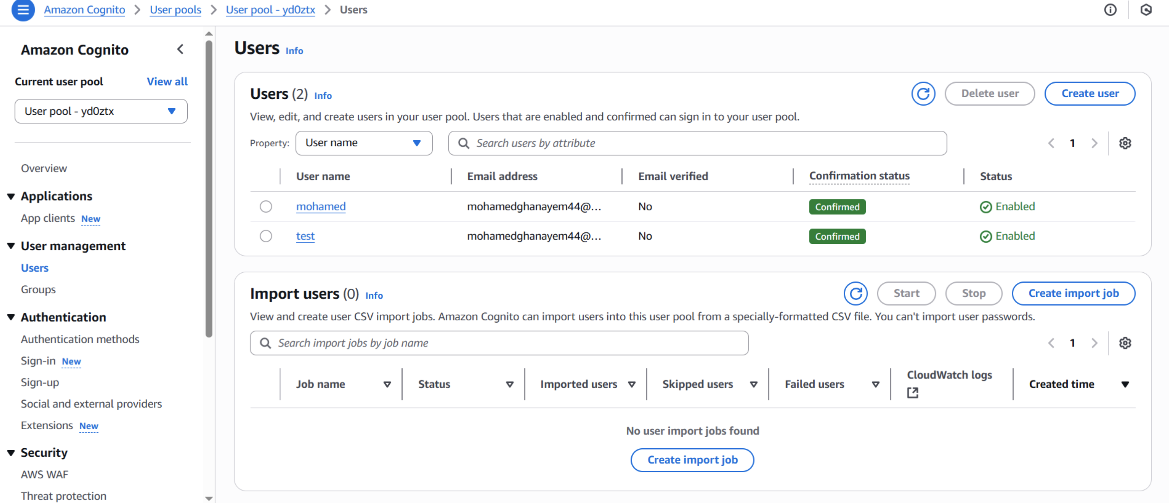
AWS Cognito

Slide 15

AWS Cognito
The amount information was encrypted. Therefor prevents revealing:
Personal habits or routines.
Health-related needs.
Targeted Exploitation or Manipulation (Ads).
AWS makes it easy to encrypt data in DynamoDB and during Lambda transfers
Builds user trust
The App respects user-privacy
Reduces risk of violating Data Protection Laws
Notes:
Raghad

Slide 16

AWS DynamoDB
NoSQL cloud database service that stores data as key-value pairs.
Fast and scalable
Doesn’t require a fixed table structure
Works great with Lambda for event-based actions
Notes:
Mohammed

Slide 17
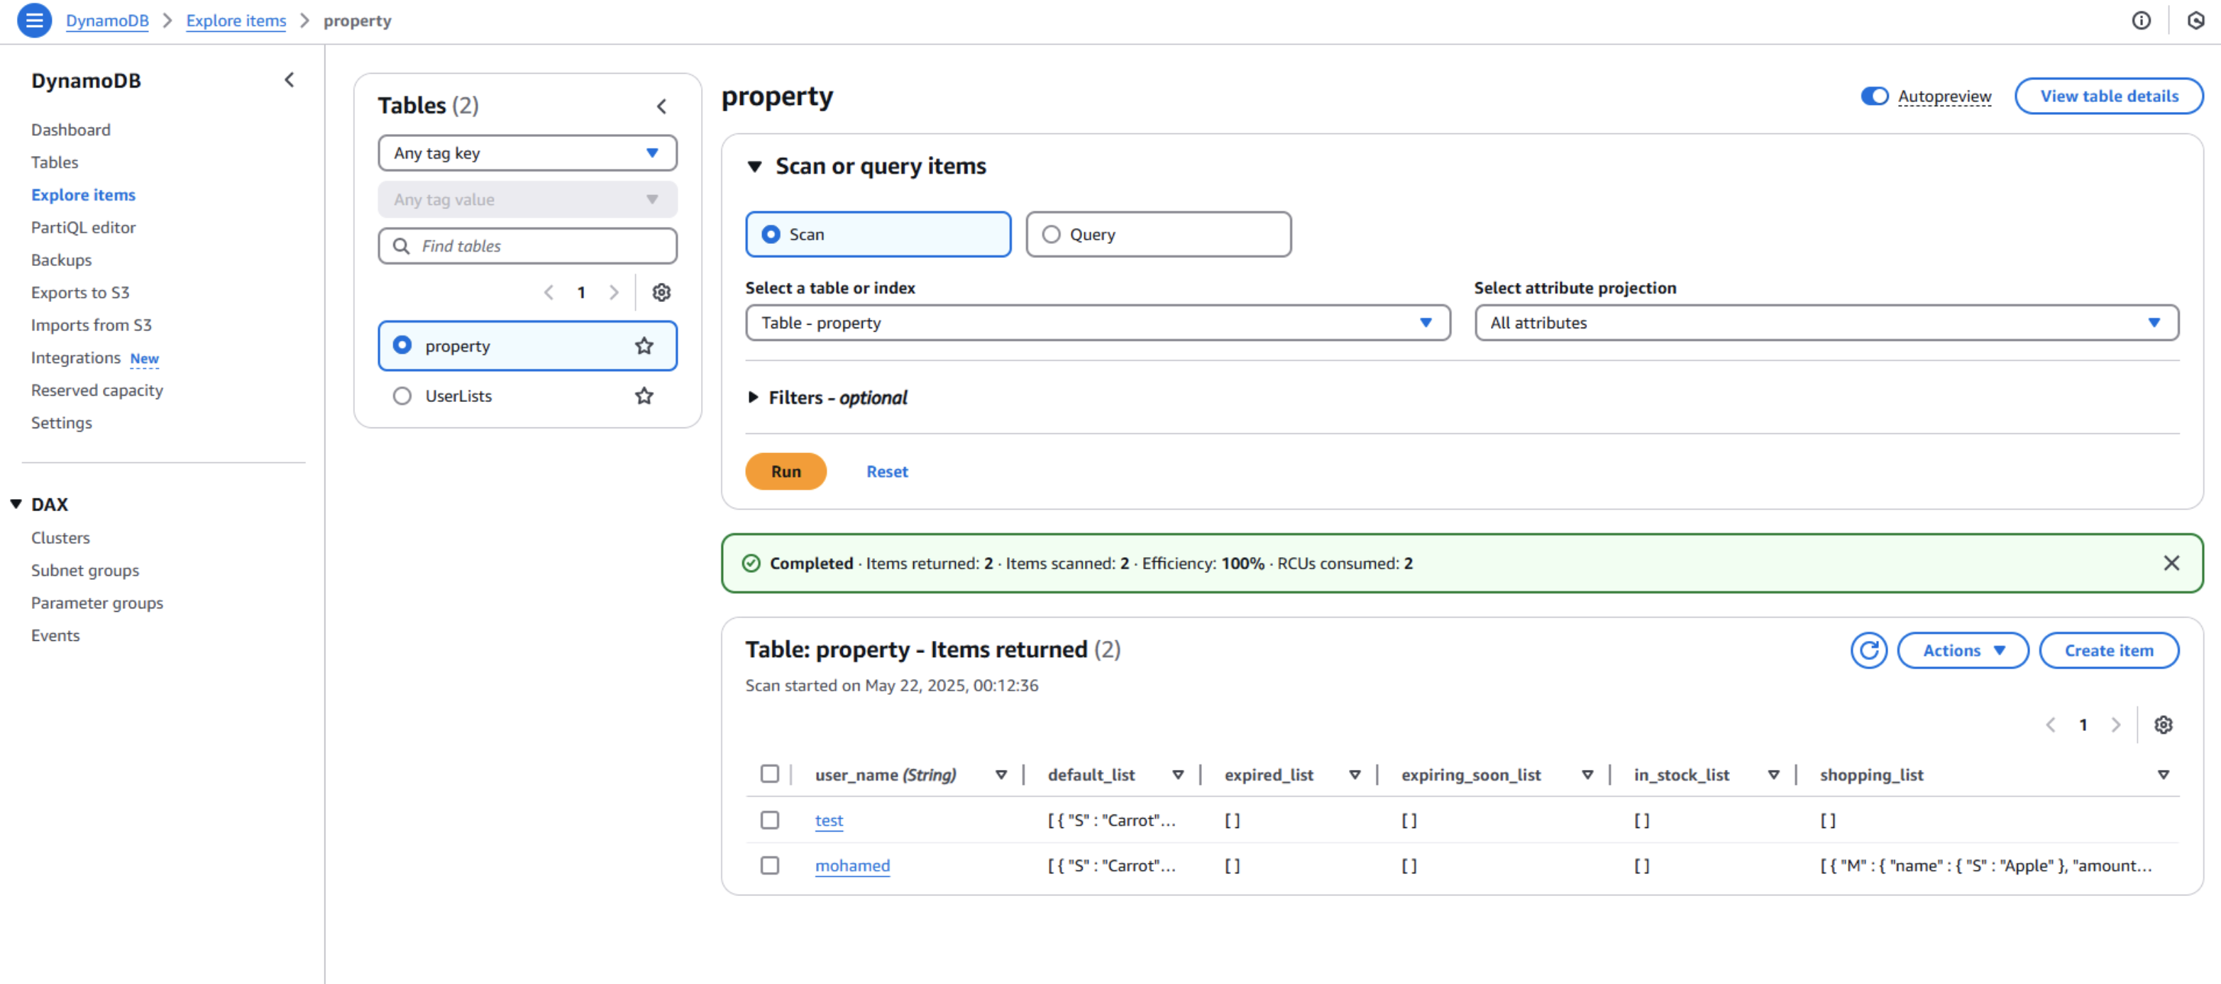
AWS DynamoDB
Notes:
Mohammed

Slide 18
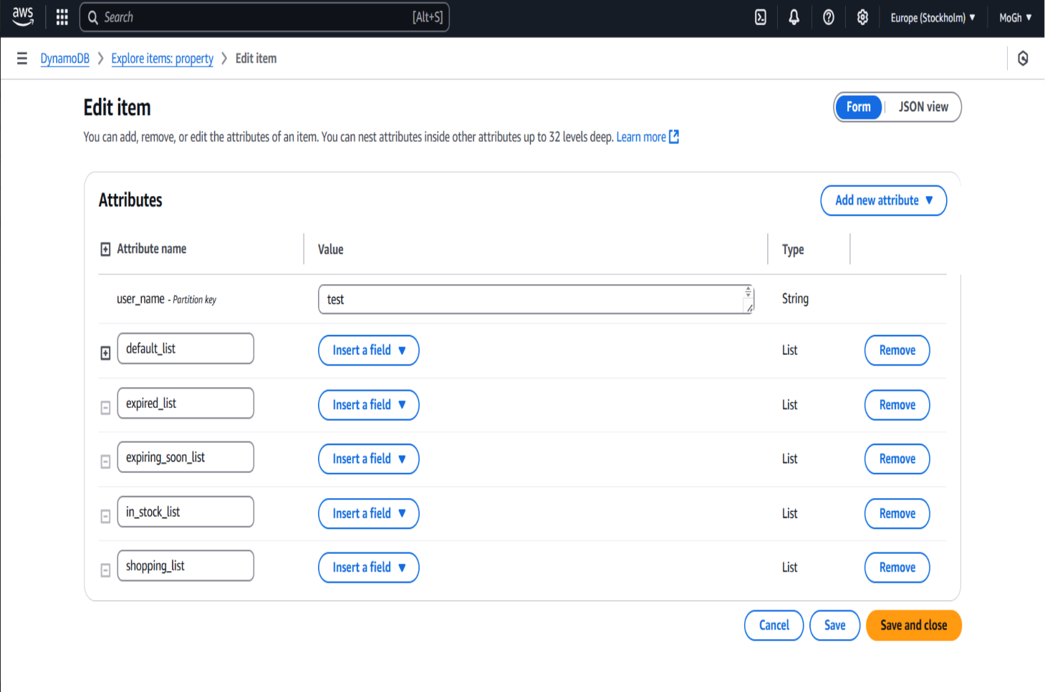
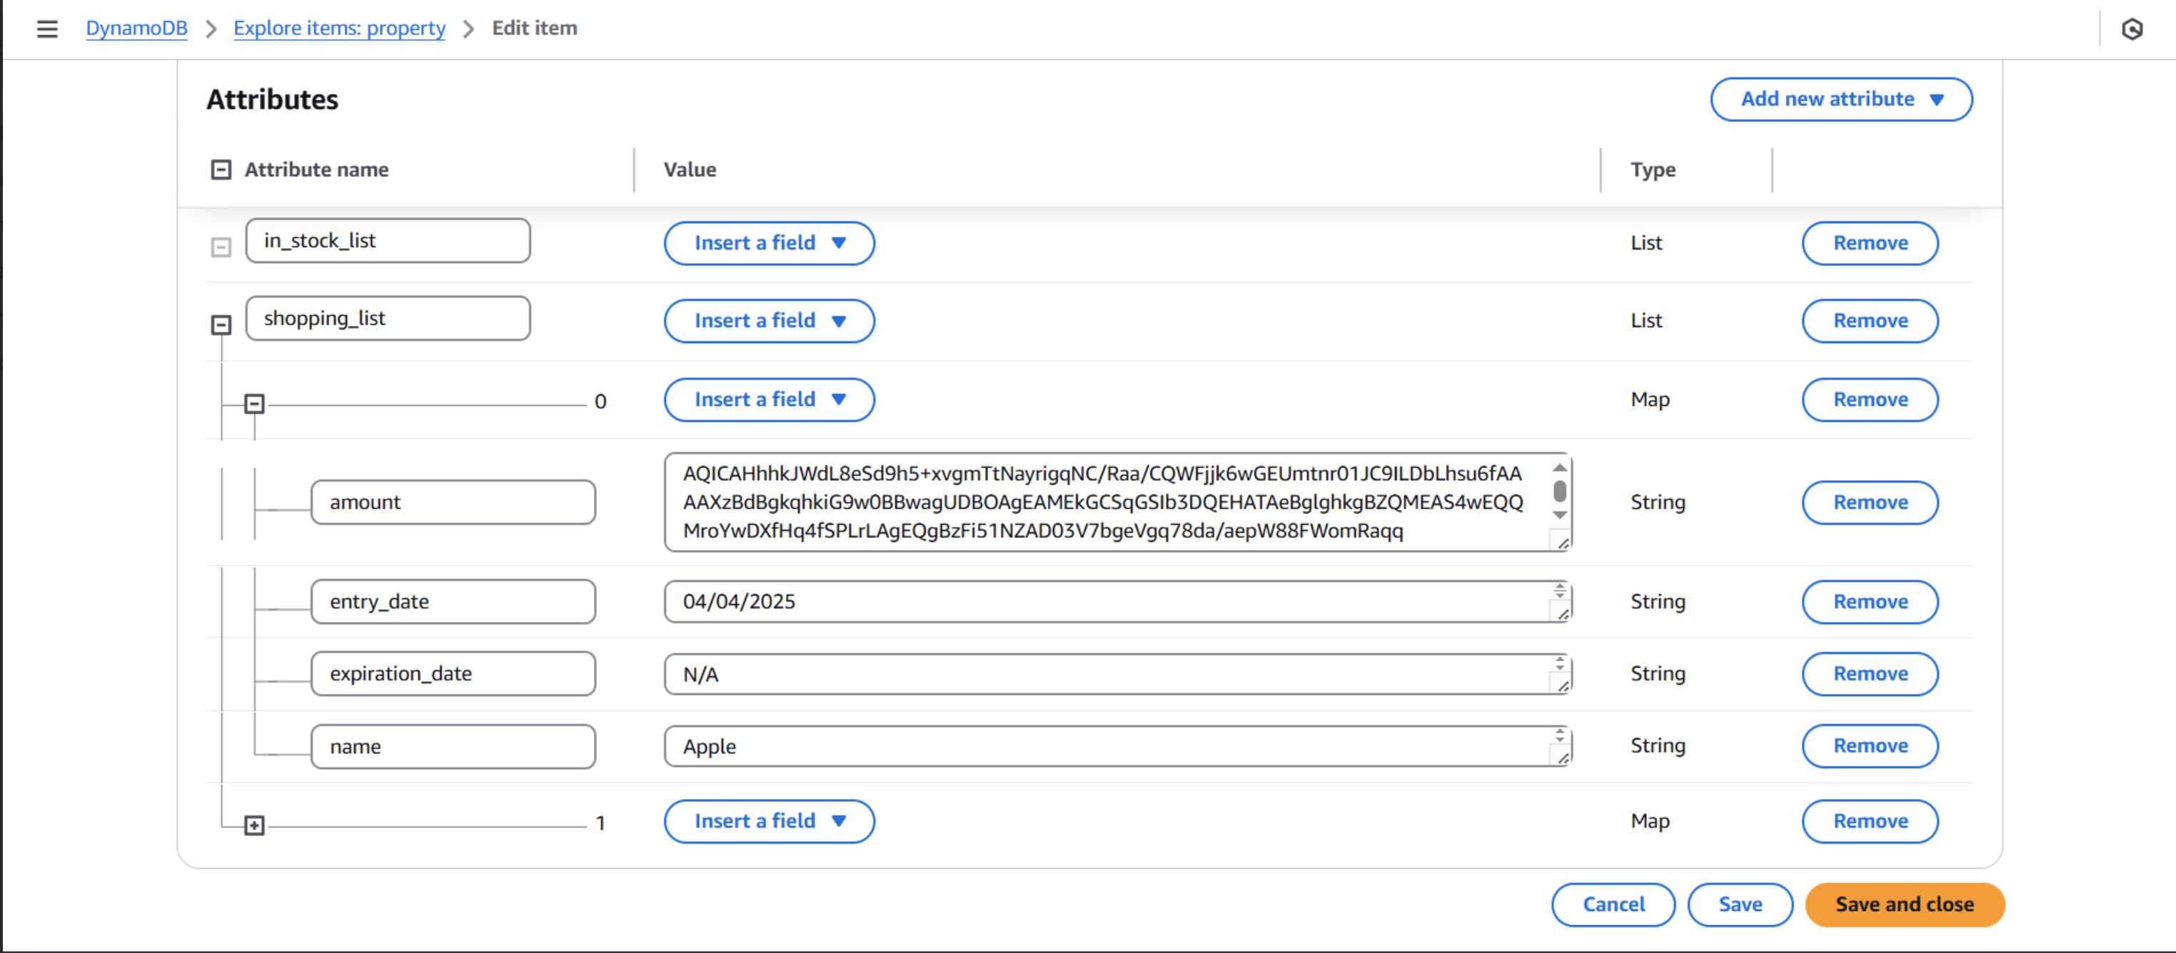
AWS DynamoDB
Notes:
Mohammed

Slide 19
How Everything Works Together
User opens the app and logs in → Login info is sent to AWS Cognito → Cognito authenticates the user and returns a token
App uses this token to interact with AWS Lambda.
AWS Lambda receives the request, checks if the user is allowed, and performs the action.
Lambda returns the result to the app, and the UI updates in real time.
Notes:
Raghad

Slide 20



In Simple Terms
AWS Cognito = login gate
AWS Lambda = worker doing tasks (like "delete this item")
AWS DynamoDB = warehouse storing your data
AWS = the entire cloud platform where this all runs
Notes:
Raghad

Slide 21
Application Flow Diagram
Does the user have an account?
Yes
User enters his account
Aws Cognito authentication
No
User tries to view shopping list
User should create an account from main system (refrigerator)
User want to make any update like delete an item
Call Lambda
Lambda Function
Fitch Shopping List
Display Shopping List
DynamoDB
Notes:
Raghas

Slide 22





Flow Diagram
User creates account
User edits an existing list
User enters item
Triggers
Creates lists
Amount Encryption
Edits lists
Encrypting item’s amount
Fitch item’s amount
Notes:
Mohammed

Slide 23
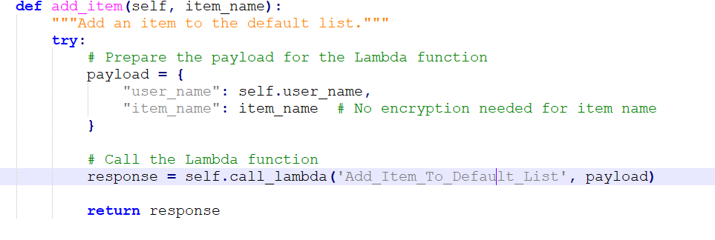
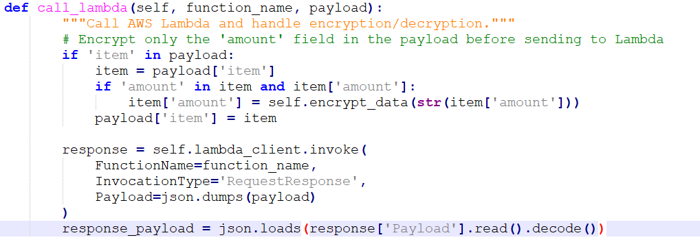
Management
item_manager.py
Call_lambda()
Lambda function ()
Notes:
Mohammed

Slide 24

Application
Simple and user-friendly.
Manages the shopping list in real time.
Fully connected to AWS cloud services, allowing it to fetch the latest shopping list from the database and display it in the app.
Any changes are immediately synced back to AWS, ensuring the data stays updated across all connected devices.
This seamless integration provides a smooth and efficient experience for managing daily shopping needs.
Notes:
Mohammed

Slide 25
Application’s Shopping List
Notes:
Mohammed

Slide 26
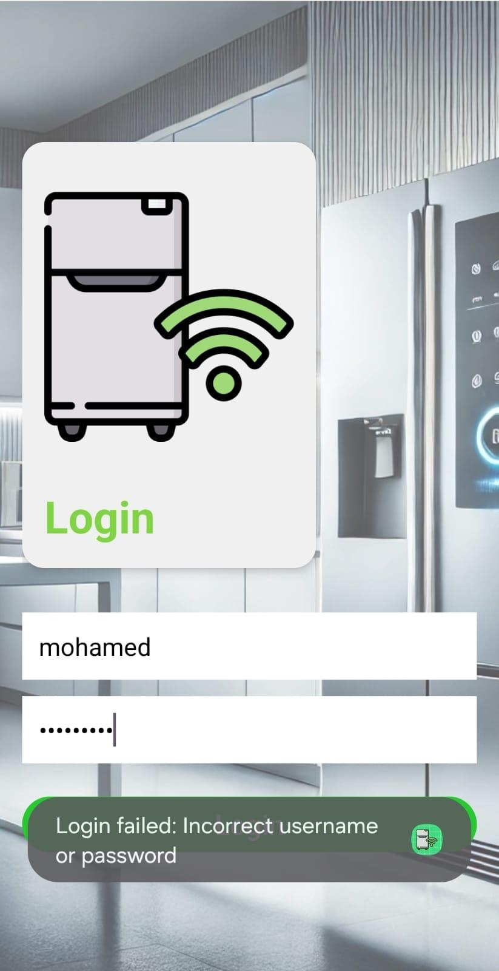
Application Testing
Incorrect username
Notes:
Mohammed

Slide 27
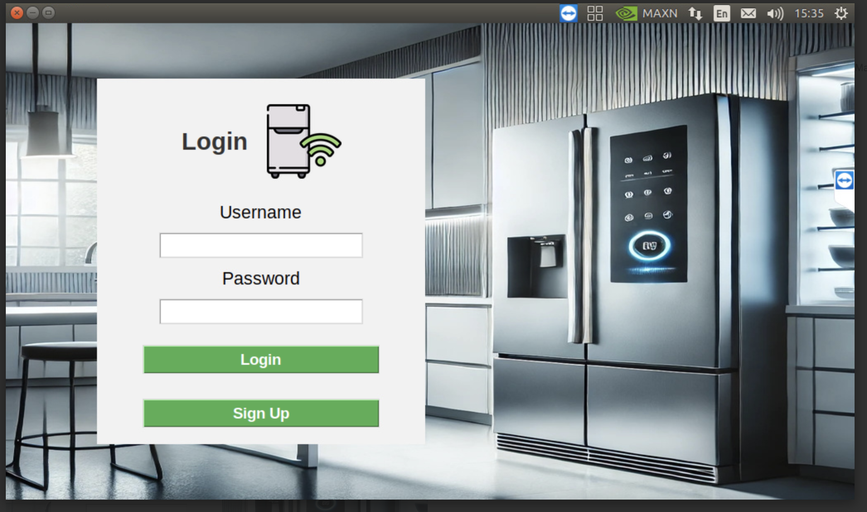
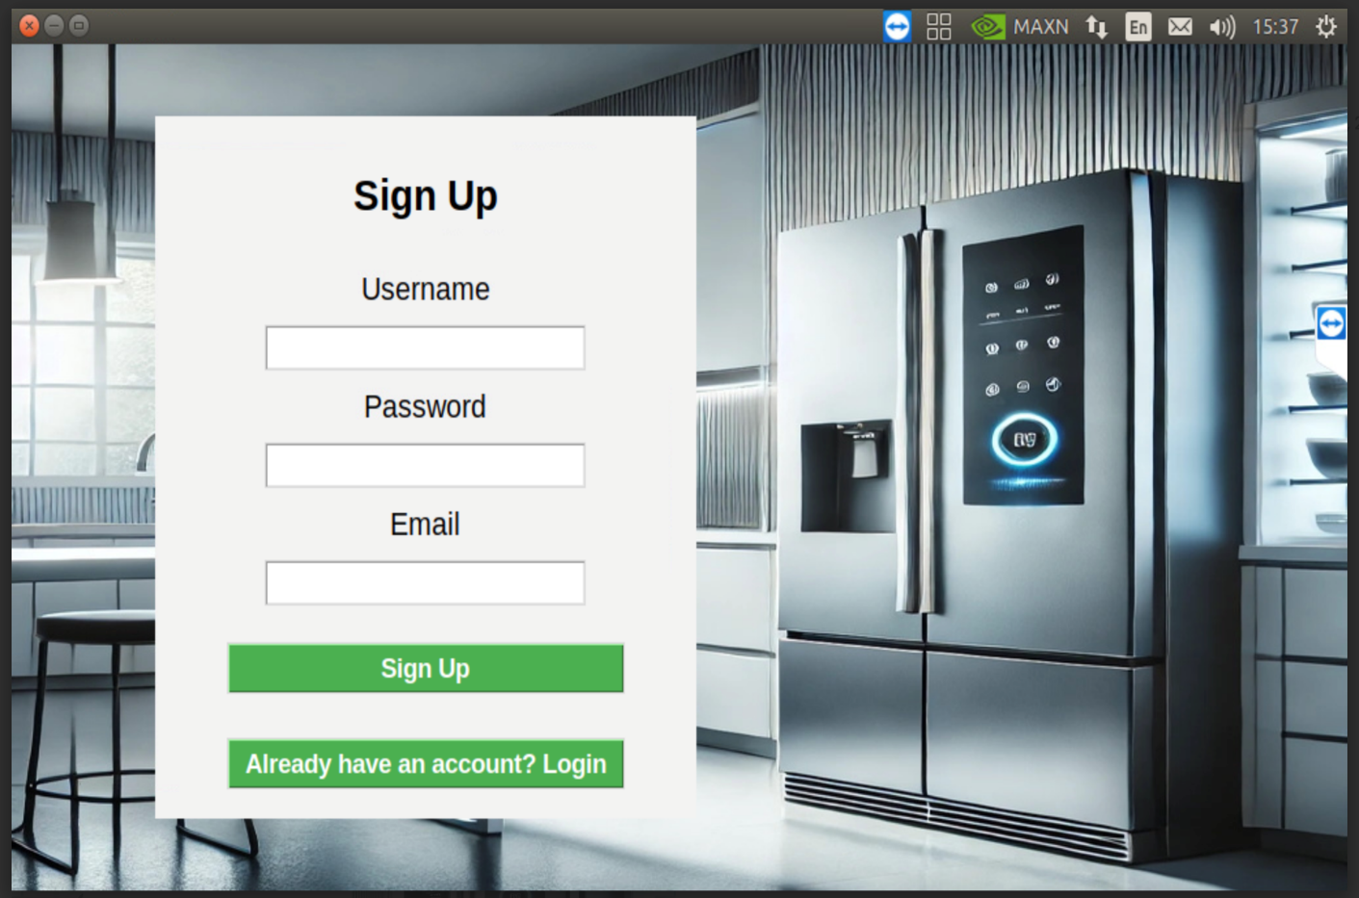
Main GUI
Creating an account
Notes:
Raghad

Slide 28
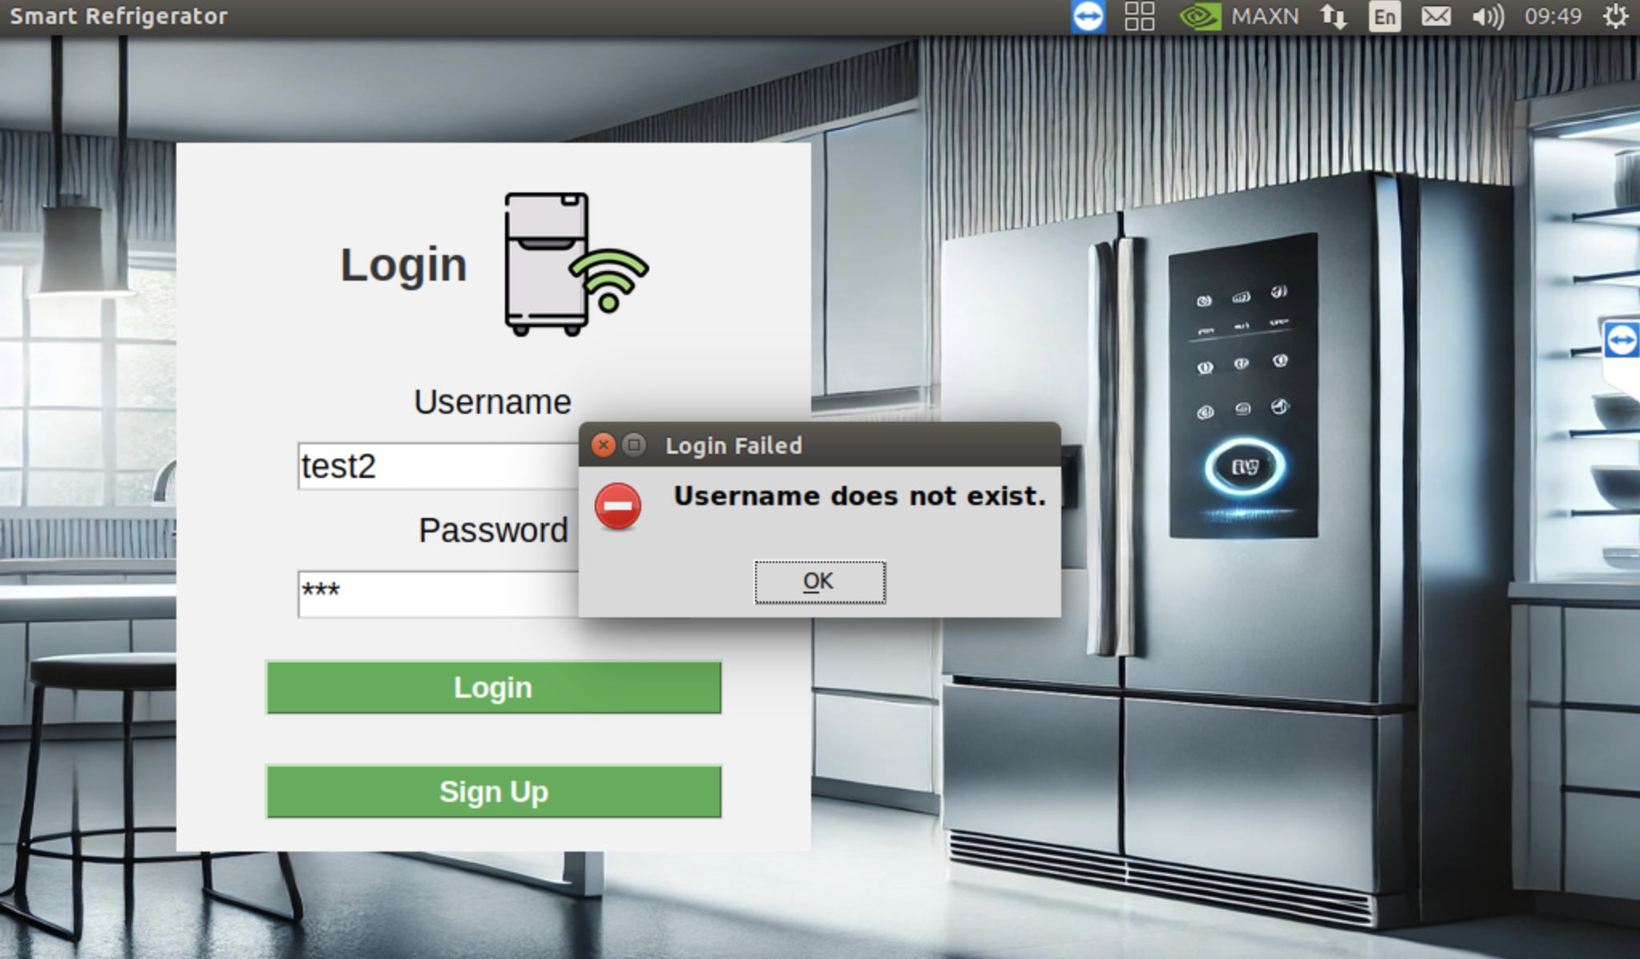
Main GUI Testing
Username Does Not Exist
Notes:
Raghad

Slide 29
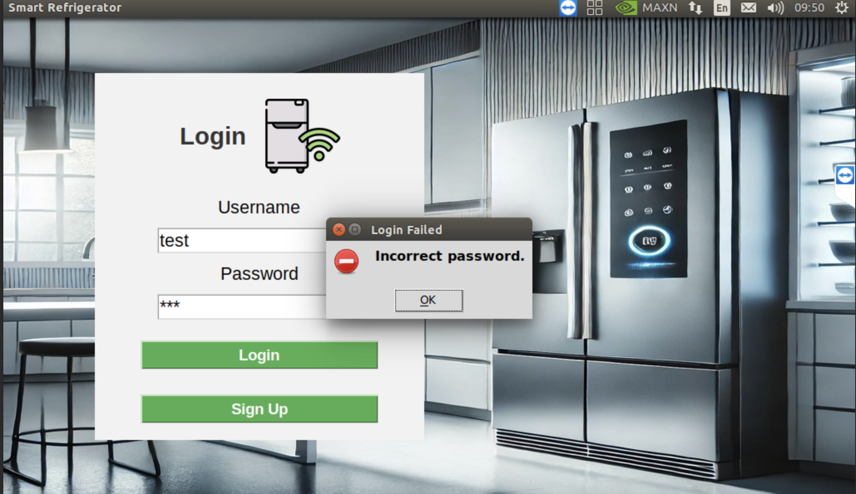
Incorrect password
Notes:
Raghad

Slide 30
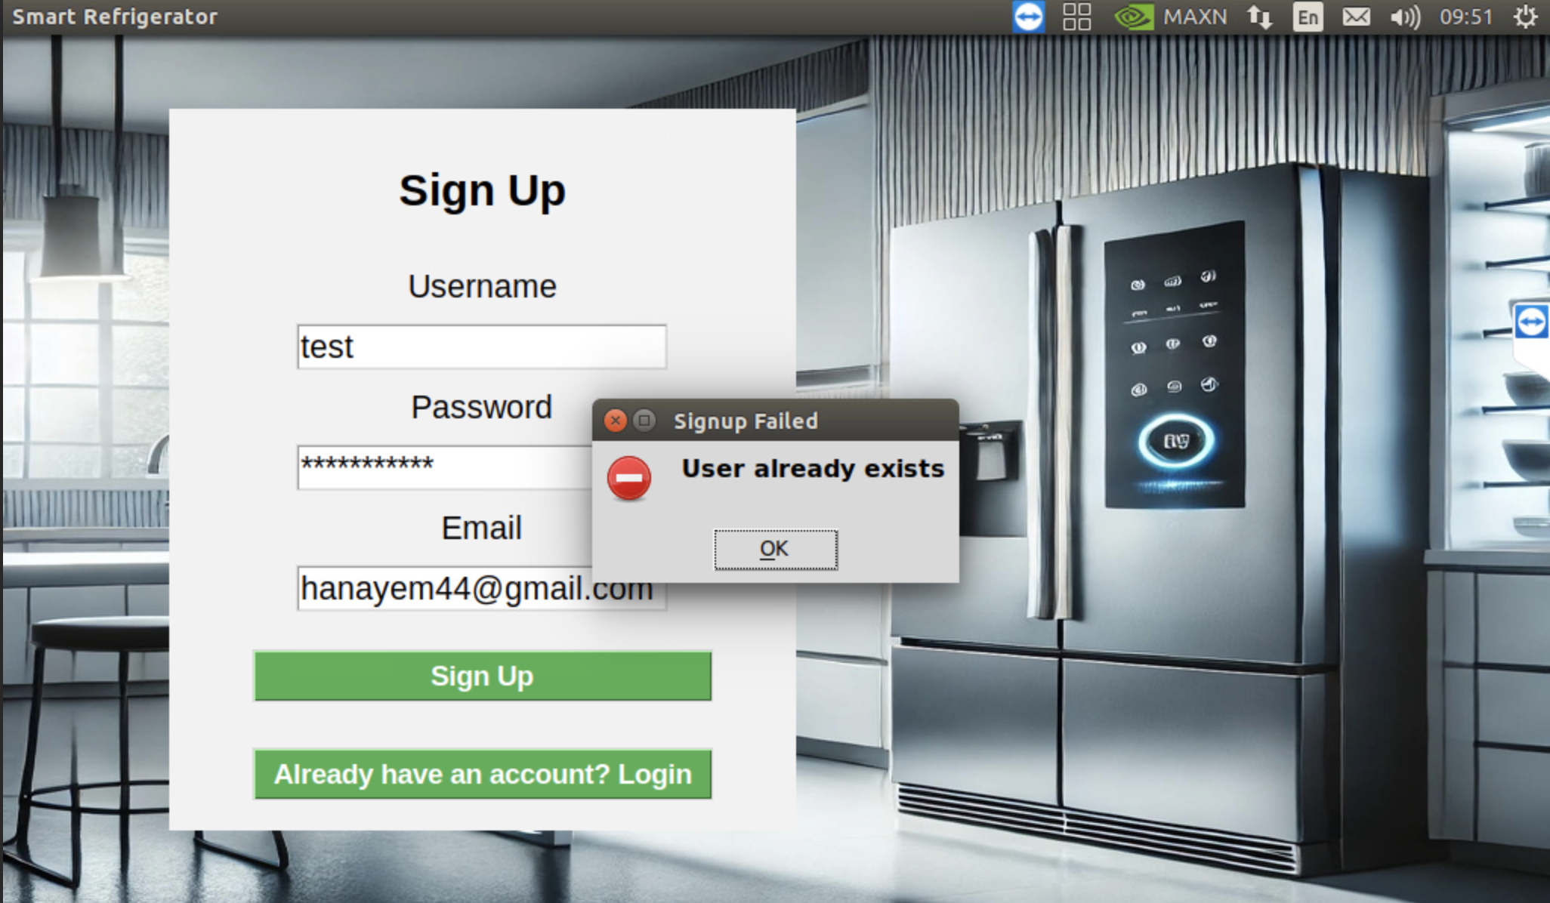
User already exist
Notes:
Raghad

Slide 31
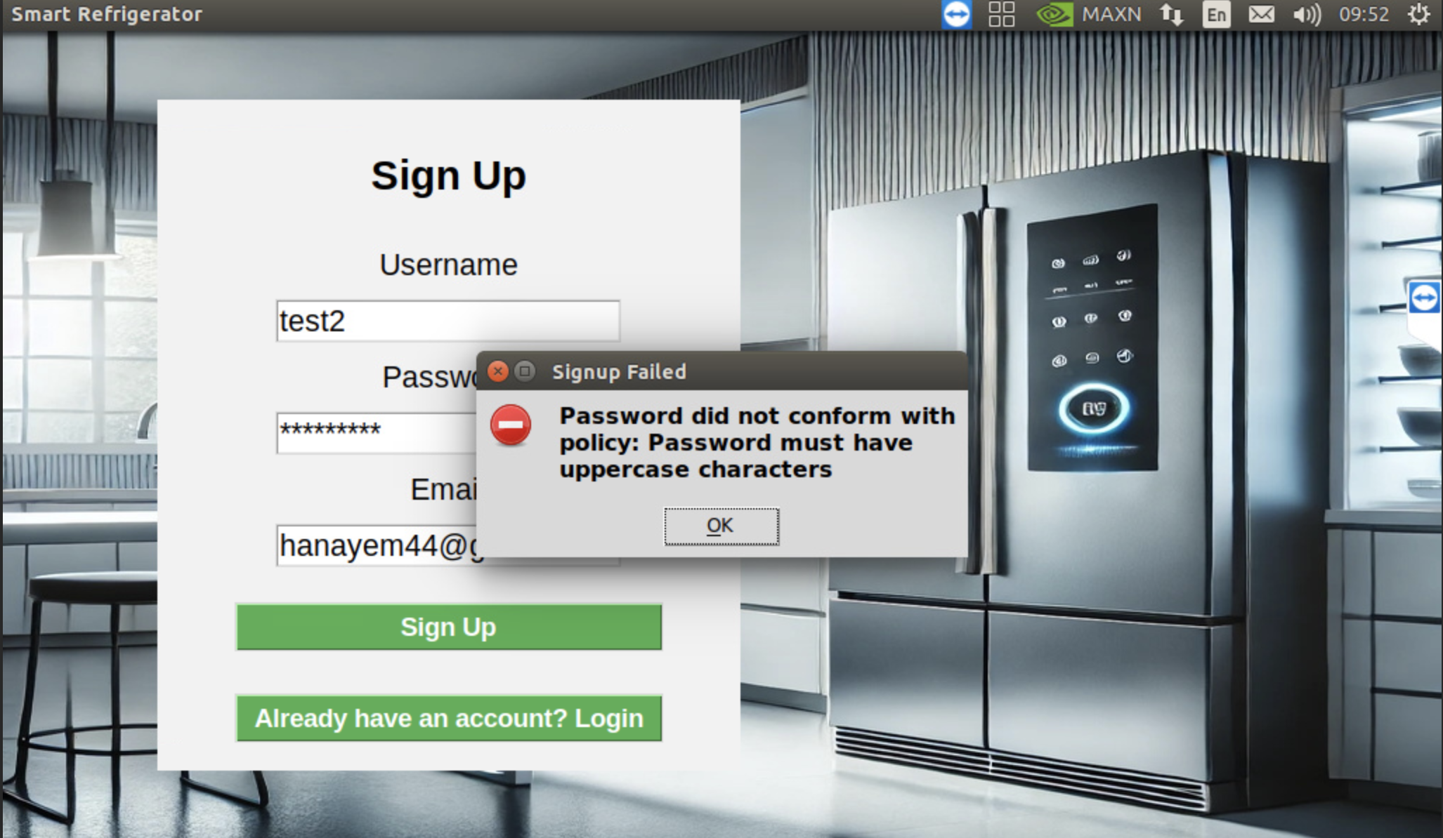
Password conditions
Notes:
Raghad

Slide 32
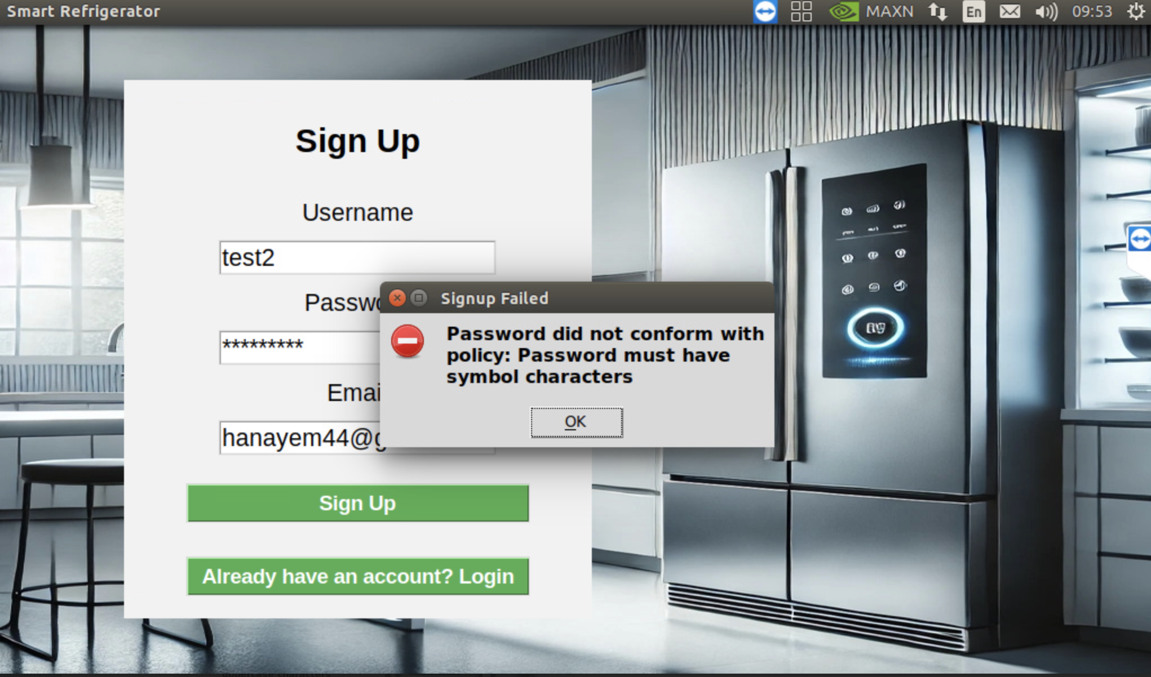
Password conditions
Notes:
Raghad

Slide 33

Password conditions
Notes:
Raghad

Slide 34
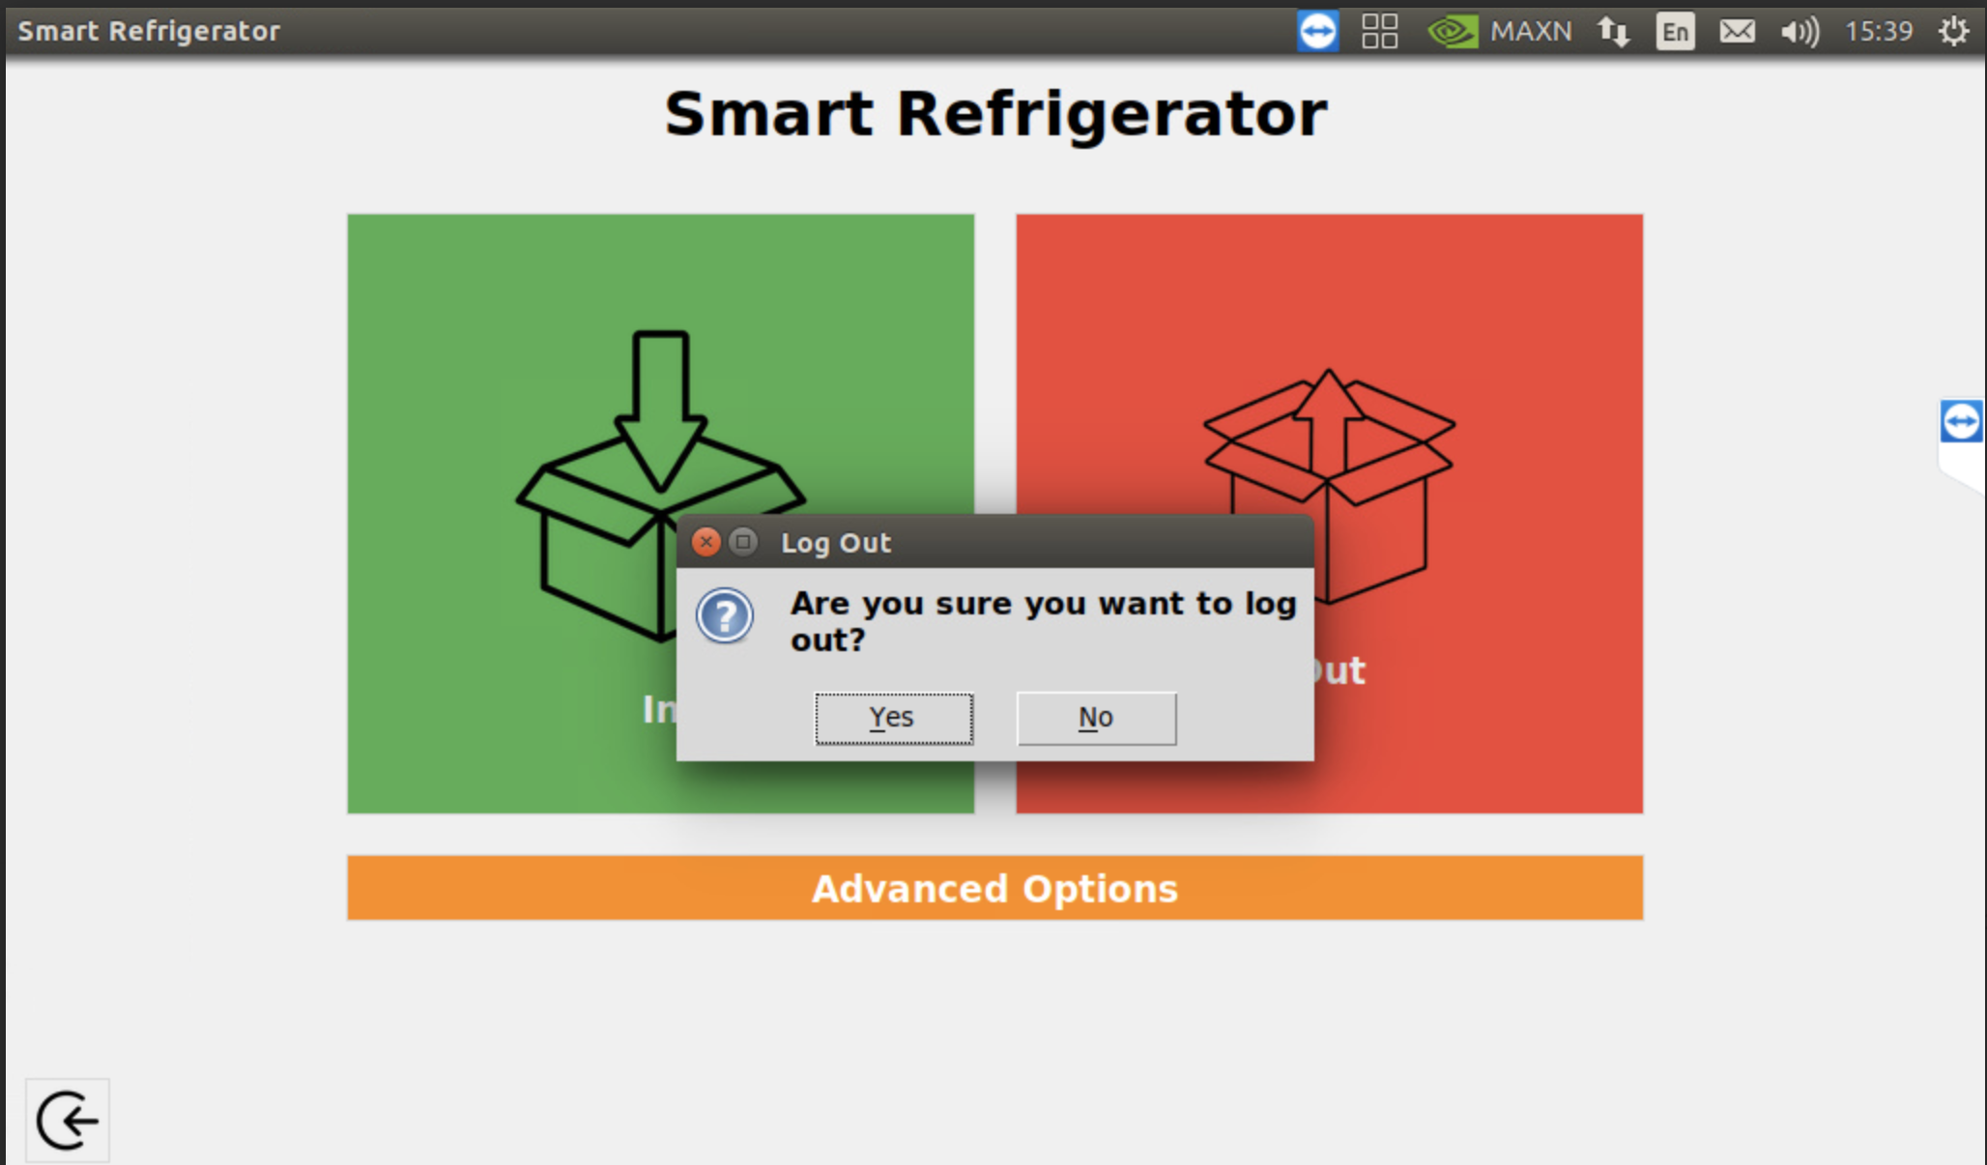
Notes:
Raghad

Slide 35
Thanks For Listening !

